Slide 1
Moneyball 2.0: Winning in Sports With Data
Spring 2018

Slide 2
Monte Carlo Simulations
You are at week 10 of NFL season. What are the chances that the Steelers will make the playoffs?
The NFL postseason just started. What are the chances each team has for winning the Lombardi trophy?
These are settings where theoretically you can calculate the probability but in practice it is too complicated
Monte Carlo Simulations: play out a complex situation several times to obtain a probability or a range of outcomes that might occur

Slide 3

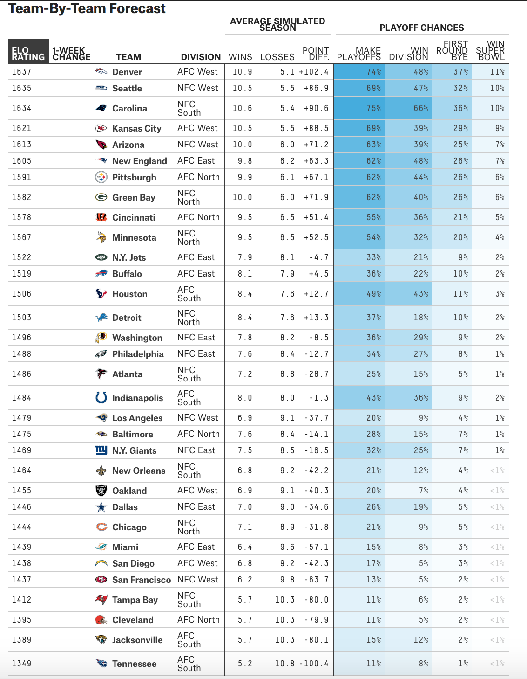

Monte Carlo Simulations
Most – if not all - of the predictions that you see in sites like fivethirtyeight.com are based on Monte Carlo Simulations
It is based on random sampling

Slide 4
Main Idea
The general idea of Monte Carlo simulations is based on uniformly random sampling
Steelers are at the AFC championship game against the Patriots and Falcons play the Packers at the NFC championship game
Steelers have a 60% chance of winning the Patriots
Packers have a 55% chance of winning the Falcons
What is the probability that Steelers and Packers will meet in the Super Bowl?

Slide 5
Main Idea
Well this probability is simple to calculate and is equal to 0.6*0.55 = 0.33
How could we use Monte Carlo Simulations to obtain the same result?
For each game flip a biased coin to decide the winner
Bias based on the precomputed probabilities for each game
Repeat the process several times (e.g., 10,000 times)

Slide 6
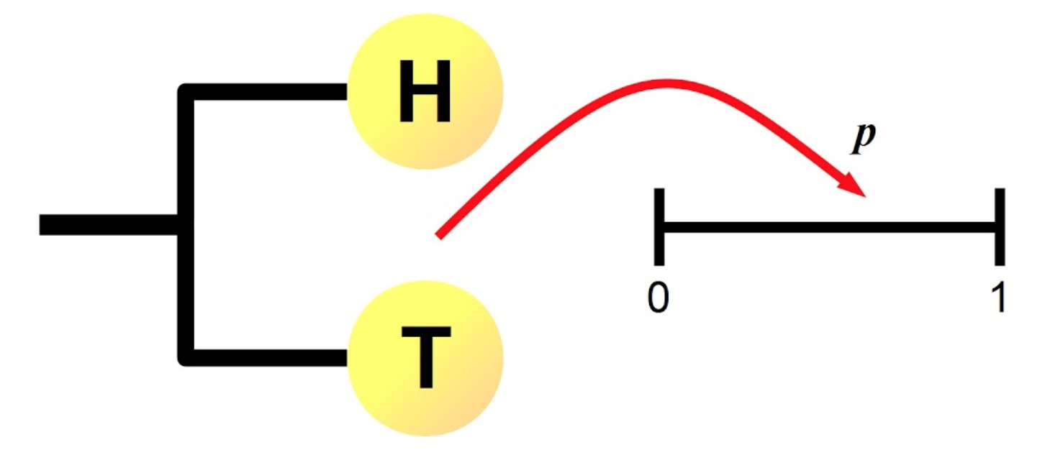
Main Idea
An unbiased coin has a 50-50 chance of landing heads or tails
How to simulate biased coins?
If we sample a uniform random distribution between 0 and 1,
the probability of getting a number in the interval [0,π] is
proportional to π.
π
Length π
1-π

Slide 7
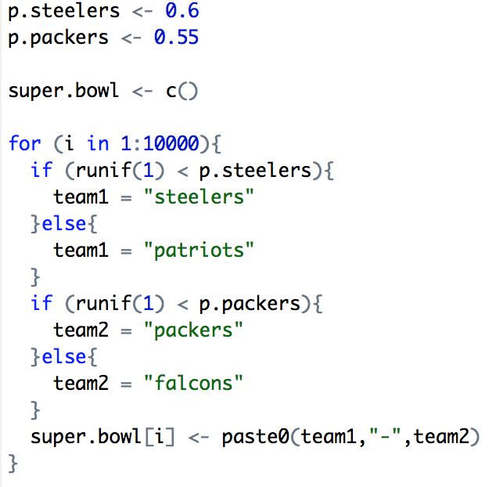
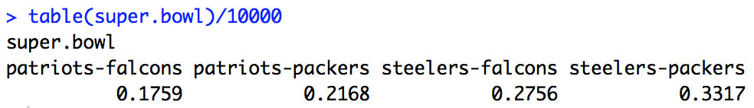

Slide 8
Monte Carlo Simulations
Monte Carlo simulations do not only simulate binary events (e.g., win/loss)
They can be used to simulate any event that can be described through an appropriate random variable distribution
Example: predict the outcome of a soccer game
Assume that for each team we know their offensive and defensive ratings as well as the home edge
An average team has a rating of 1

Slide 9
Monte Carlo Simulations
An offensive rating of 1.34 means that the team is 34% better than an average offensive team offensively
A defensive rating of 1.34 means that the team is 34% worse than an average defensive team
We also can estimate an average number of goals for the home and away teams
How can we use these to simulate the outcome of a soccer game?

Slide 10
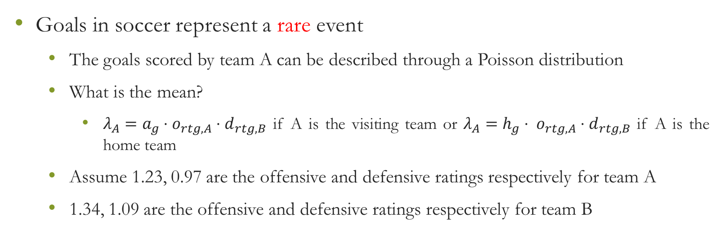
Monte Carlo Simulations
Goals in soccer represent a rare event
The goals scored by team A can be described through a Poisson distribution
What is the mean?
$λ_{A}=a_{g}⋅o_{rtg,A}⋅d_{rtg,B}$ if A is the visiting team or $λ_{A}={h_{g}⋅ o}_{rtg,A}⋅d_{rtg,B}$ if A is the home team
Assume 1.23, 0.97 are the offensive and defensive ratings respectively for team A
1.34, 1.09 are the offensive and defensive ratings respectively for team B

Slide 11
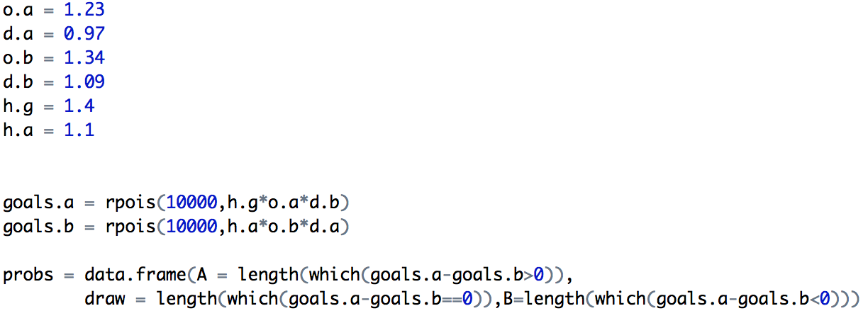
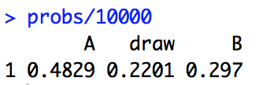

Slide 12
Bootstrap
Monte Carlo assume that we know the distribution/parameters that capture the uncertainty in our setting
The simulation simply allows us to synthesize all of the individual uncertainty to a more complex setting
What if we do not know the distribution but we only have a set of observations?
E.g., assume that our simulations require as input the number of points to be scored by the Celtics

Slide 13
Bootstrap
We have a sample for the first 50 games of the season
We could make an assumption for the distribution and use the sample mean and variance
Normal distribution seems like an assumption that someone could readily make since it has been the case in many other situations (possibly unjustified)
A better option is to use bootstrap!

Slide 14
Bootstrap
Estimate properties of an estimator through resampling with replacement
Assumption: observed data are sampled randomly from the original population
Typically we have only one sample - of n points - observed for our variable of interest (e.g., field goal % for a team’s season games)
We can obtain a sample estimate (e.g., for the mean) but we cannot estimate the distribution of this estimator
The distribution is what Monte Carlo simulations need as input!

Slide 15
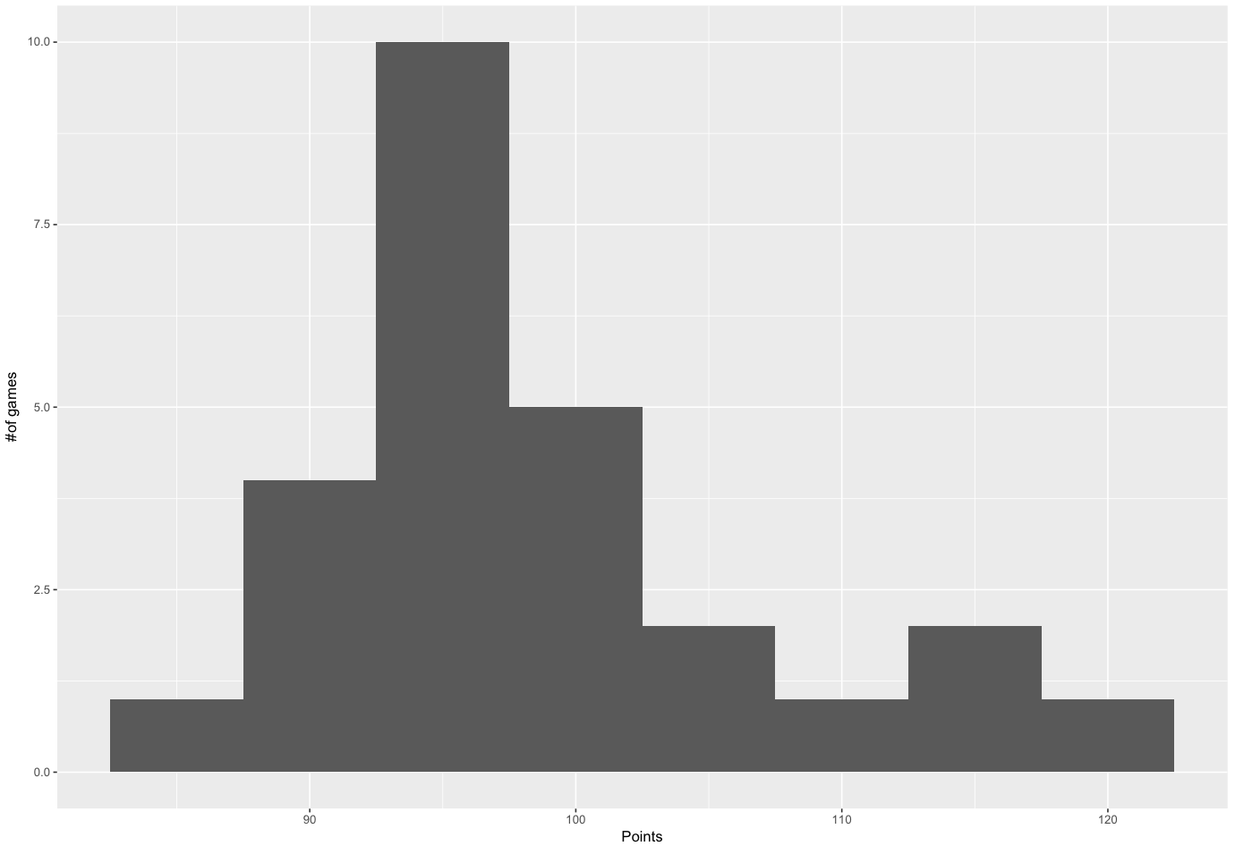
Bootstrap Illustration
Points scored by Celtics team during their first 50 games
What is the average number of points scored by the Celtics per
game?
We can obtain the average sample estimator (98.4)
However, we do not know the distribution of the estimator
Resampling with replacement will allow us to learn more about the estimator

Slide 16
Bootstrap Illustration
$$X=\{98, 100, 101, 79, 86, 98, 110, 92, 95, 114\}$$
Original Sample

Slide 17
Bootstrap Illustration
$$X=\{98, 100, 101, 79, 86, 98, 110, 92, 95, 114\}$$
Original Sample

Slide 18
Bootstrap Illustration
$$X=\{98, 100, 101, 79, 86, 98, 110, 92, 95, 114\}$$
Original Sample
X₁ = {100}

Slide 19
Bootstrap Illustration
$$X=\{98, 100, 101, 79, 86, 98, 110, 92, 95, 114\}$$
Original Sample
X₁ = {100, 110}

Slide 20
Bootstrap Illustration
$$X=\{98, 100, 101, 79, 86, 98, 110, 92, 95, 114\}$$
Original Sample
X₁ = {100, 110, 114}

Slide 21
Bootstrap Illustration
$$X=\{98, 100, 101, 79, 86, 98, 110, 92, 95, 114\}$$
Original Sample
X₁ = {100, 110, 114, 110}

Slide 22
Bootstrap Illustration
$$X=\{98, 100, 101, 79, 86, 98, 110, 92, 95, 114\}$$
Original Sample
X₁ = {100, 110, 114, 110, 98}
First Bootstrap Sample
…
X_{B} = {98, 101, 95, 79, 100}
B-th Bootstrap Sample

Slide 23
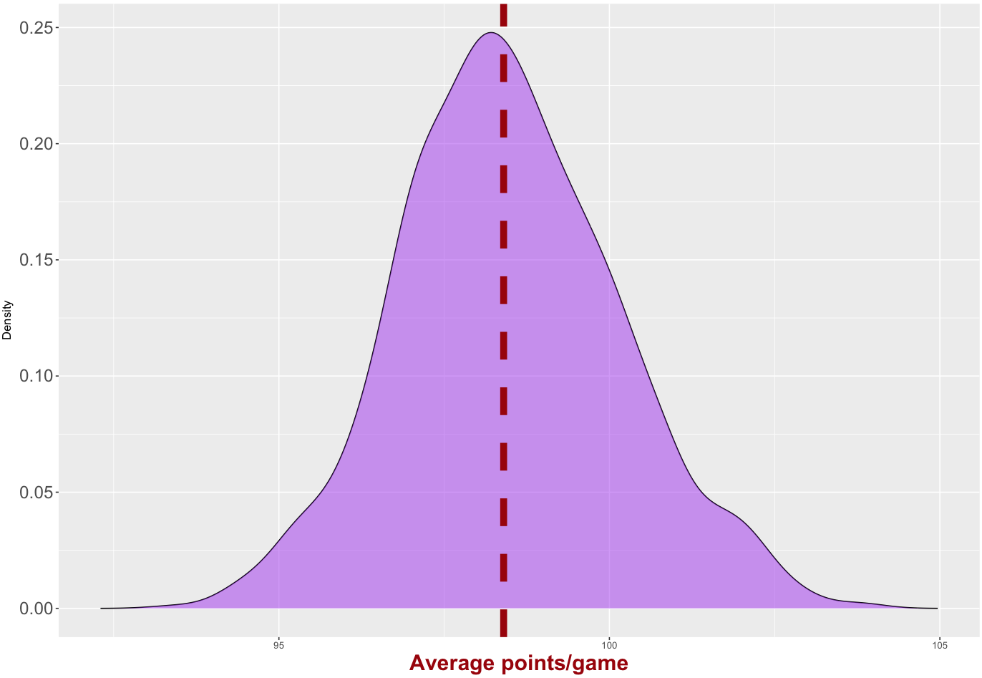
Bootstrap Illustration
Through bootstrap we can identify the
distribution of the estimator at hand and
use it for our simulations
For multidimensional data with corre-
lations block bootstrap can be used

Slide 24
Biased Bootstrap
Many team statistics can be inflated or deflated from variable schedule strength
A team might have played with bad defensive teams, hence inflating their average ppg and vice versa
In this case biased bootstrap (b-boostrap) can help account for this situation
B-bootsrap is still a resampling with replacement method
Resampling is not uniformly at random
Probabilities are biased depending on the application

Slide 25
Biased Bootstrap
Consider the previous example for the Celtics’ points per game
Celtics are playing the San Antonio Spurs and we want to obtain an estimate of the points that Celtics will score
Spurs are a better than average defensive team
Celtics play in the Eastern conference which has worse than average defenses (and offenses…)
Simply estimating the bootstrap distribution as previously does not seem a good idea

Slide 26
Biased Bootstrap
Let’s assume that the Spurs have a defensive rating of d_{Spurs} -4.5 points (we will see later in the class how to compute similar ratings)
This means that the Spurs are 4.5 points better in defense than an average team, i.e., they allow 4.5 points less than the average NBA team
How can we use this information for answering our question ?
B-bootstrap based on defensive rating

Slide 27
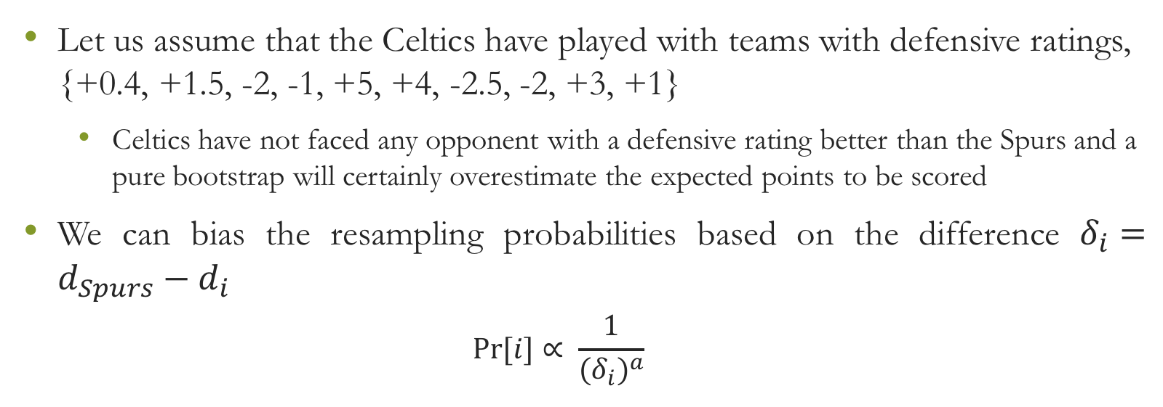
Biased Bootstrap
Let us assume that the Celtics have played with teams with defensive ratings, {+0.4, +1.5, -2, -1, +5, +4, -2.5, -2, +3, +1}
Celtics have not faced any opponent with a defensive rating better than the Spurs and a pure bootstrap will certainly overestimate the expected points to be scored
We can bias the resampling probabilities based on the difference $δ_{i}=d_{Spurs}−d_{i}$
$$Pr[i]{∝ \frac{1}{{(δ_{i})}^{a}}}$$

Slide 28
Biased Bootstrap
Performances against teams with similar defensive rating to the Spurs will be sampled more aggressively
Obviously one can use more than one variables to calculate the bias term
E.g., for simulating future matchups one might need to control for both offensive and defensive ratings, for home edge etc.

Slide 29
Why does bootstrap work?
Bootstrap almost look as magic!
The way traditional inferential statistics work is that we have a population and we randomly sample a set of points to infer the statistic of interest
Ideally we would take several samples from the population and for each sample calculate the statistic of interest
Estimate variability of the statistic

Slide 30
Why does bootstrap work?
Getting several samples from the population is not practical/realistic
Solution 1 (inferential statistics): make assumptions for the shape of the population
Solution 2 (bootstrap statistics): use information from the (single) population sample that you have
The sample that we have is a (smaller) population itself with the same shape as the original population

Slide 31
Why does bootstrap work?
In this case resampling with replacement simulates the generation of multiple samples from the original population
Replacing back the sampled data point retains the shape of the original population
The sample is the best information – and in fact the only information- we have for the population and bootstrap takes maximum advantage of it

